Slide 1
Presentation On Project
D2D Food Delivery

Slide 2
CONTENT
Abstract
Introduction
Objective
Feature Scope
Technologies
Modules
Diagrams
Goal
Reference
Implementation Screenshots

Slide 3
ABSTRACT
The online food ordering system set up menu online and the customers easily places the order with a simple mouse click. Also with a food menu online you can easily track the orders, maintain customer's database and improve your food delivery service. This system allows the user to select the desired food items from the displayed menu. The user orders the food items. The payment can be made online or pay-on-delivery system. The user’s details are maintained confidential because it maintains a separate account for each user. An id and password is provided for each user. Therefore it provides a more secured ordering.
The online food ordering system provides convenience for the customers. It overcomes the disadvantages of the traditional queuing system. This system increases the takeaway of foods than visitors. Therefore, this system enhances the speed and standardization of taking the order from the customer. It provides a better communication platform.

Slide 4
INTRODUCTION
Online food ordering is the process of ordering food from a website.
The aim of developing Online Food Ordering system project is to replace the traditional way of taking orders with computerized system.
A customer can choose to have the food delivered or for pick-up.
Online Food Ordering System has a very lot of scope. This PHP project can be used by any restaurants or fast foods for customers for keeping their order records.

Slide 5
Technologies
Front-end: Java Script, CSS, Bootstrap, HTML
Back-end: MySQL Database (phpMyAdmin)
Web-Server: Apache, Xampp

Slide 6
Objective
The main objective of this system is to manage the details of item category, food, delivery address, order, and shopping cart. It manages all the information about item category, customer, shopping cart, item category. The project is totally built at administrative end and thus only the administrator is guaranteed the access. The purpose is to build and application program to reduce the managing the item category, food customers. It tracks all he delivery address ordered.
The main objective of this project is to develop an application which gives provision to the restaurant owners to flourish their business by uploading menus at no cost and will invariably lead to higher customer retention and acquisition rates.

Slide 7
Feature Scope
The Scope of the project (web panel based application) are as follows: Food Ordering app can sale Food product, preferred brands, kitchen needs, essential restaurant supplies and more, through this online, one- stop Food store. It provides you with a convenient way to sale from your Food shopping app.

Slide 8
Modules And Activities Features
Administrator Module
* Create food category
* Manage food categories
* Add food item
* Manage Food item
* Manage user order
Customer Module
* View product’s list
* Register
* Place orders

Slide 9
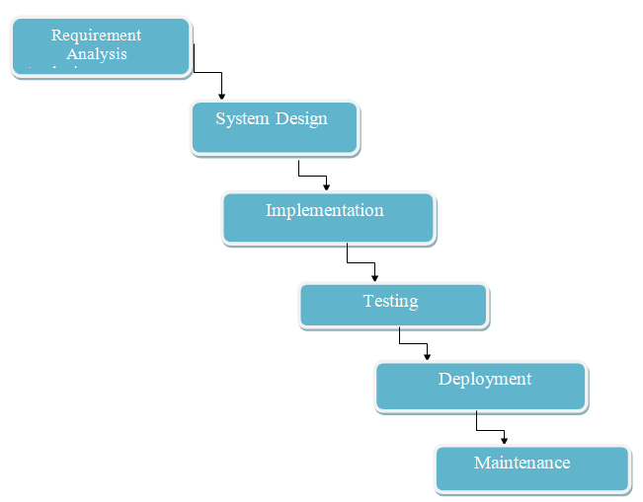
Diagram

Slide 10
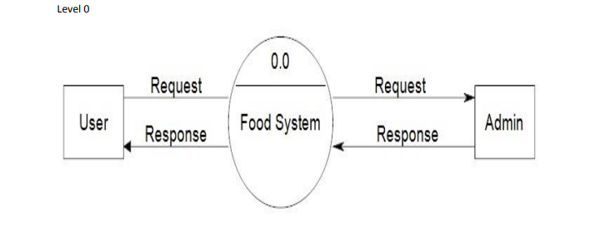
Data Flow Diagram(Context Level)

Slide 11
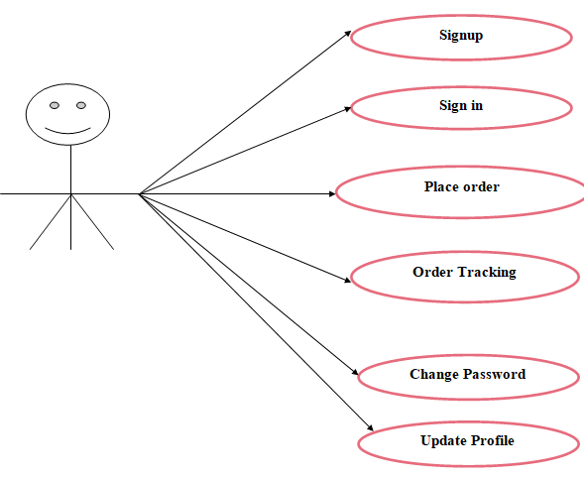
User Use Case Diagram

Slide 12
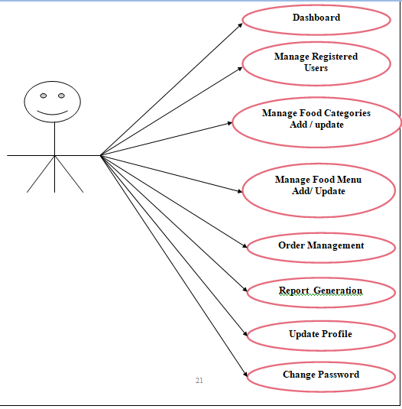
Admin Use Case Diagram

Slide 13
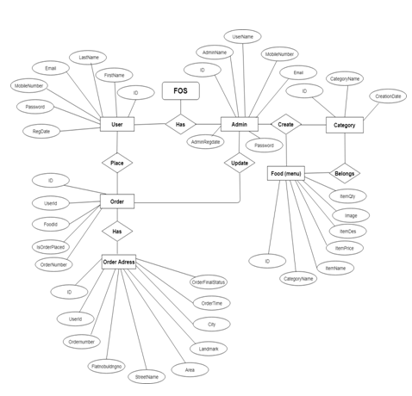
ER Diagram

Slide 14
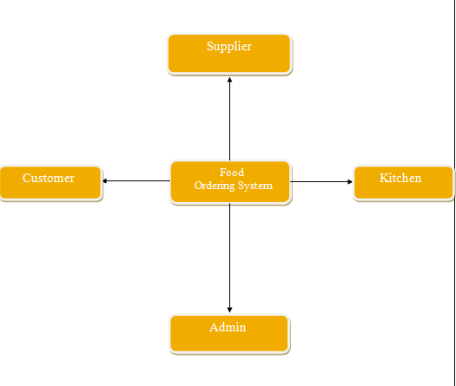
Data Flow Diagram(Level 0)

Slide 15
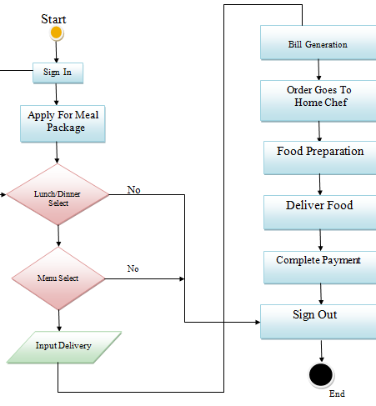
Activity Diagram

Slide 16
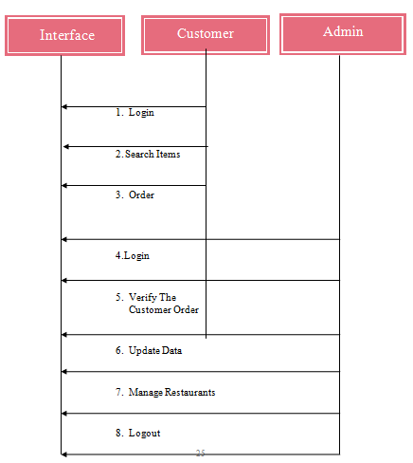
Sequence Diagram

Slide 17
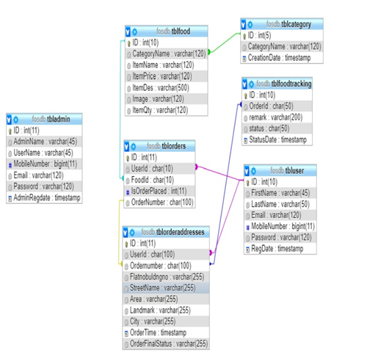
Tables Relations Diagram

Slide 18
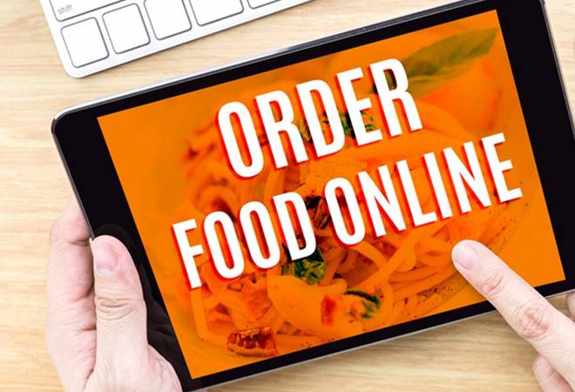
Goal
Improve New Revenue Streams
Improve Your Top-Selling Items
Test New Menu Items
Test Service Charges.

Slide 19
Reference
Php
https://www.w3schools.com/php/default.asp
https://www.sitepoint.com/php/
https://www.php.net/
My SQL
https://www.mysql.com/
http://www.mysqltutorial.org
Xampp
https://www.apachefriends.org/download.html

Slide 20
Implementation Screenshots

Slide 21
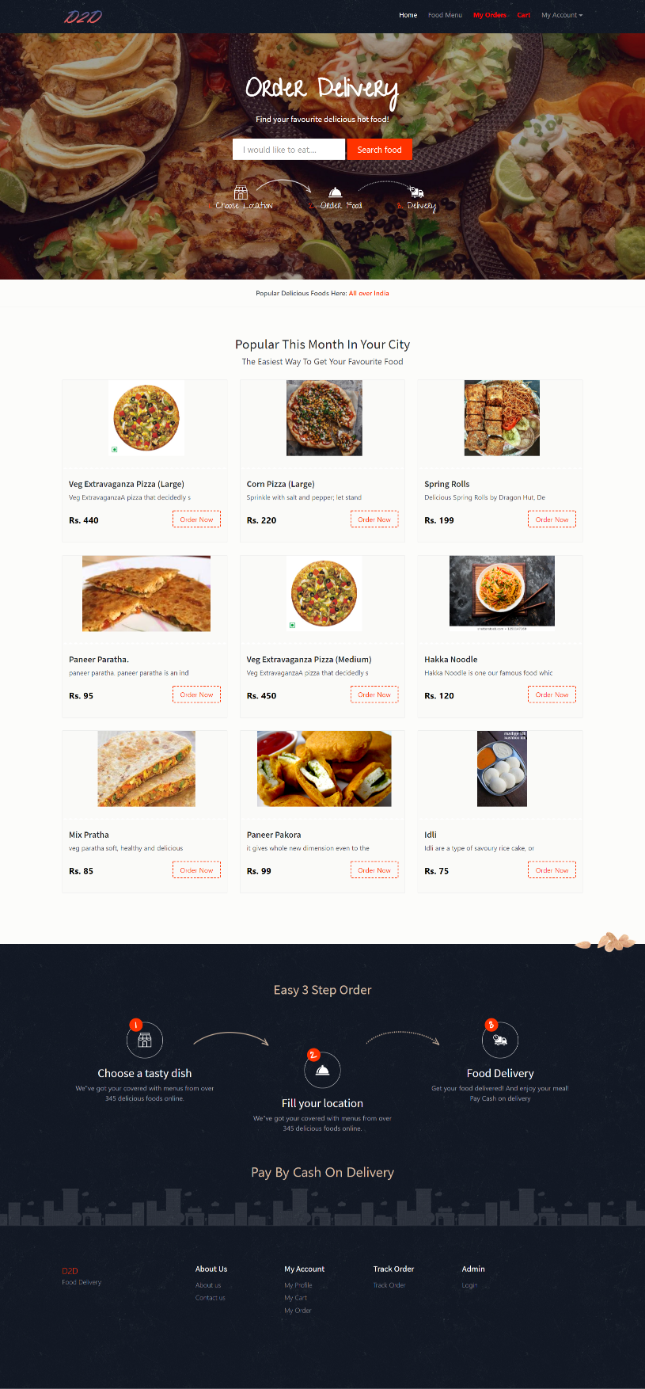
Home Page

Slide 22
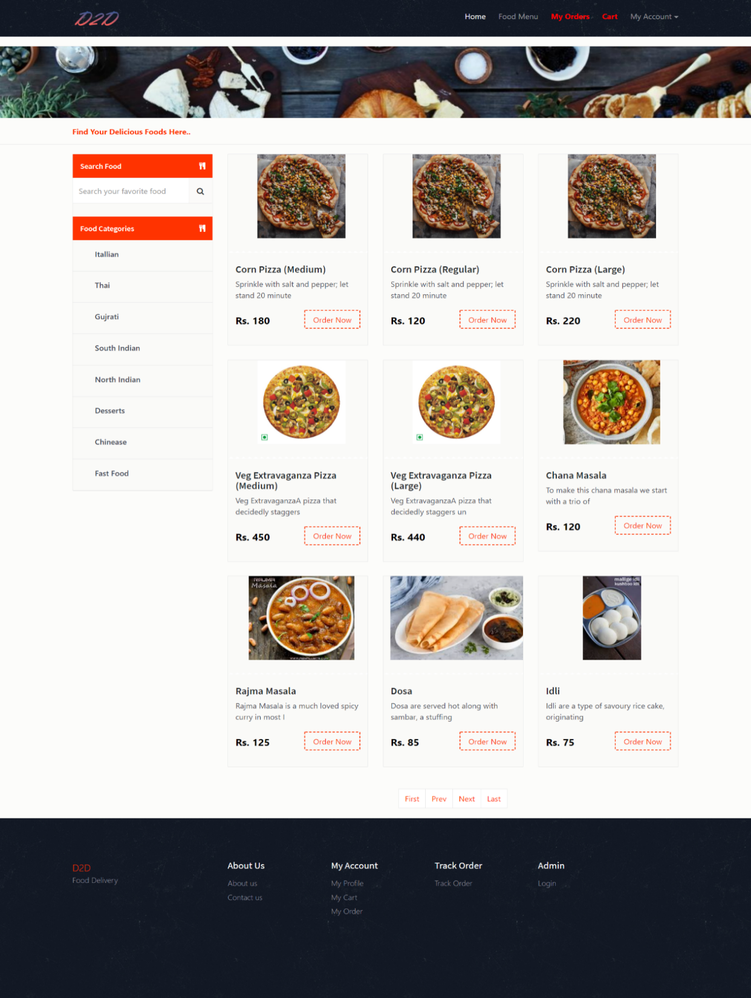
Food Menu

Slide 23
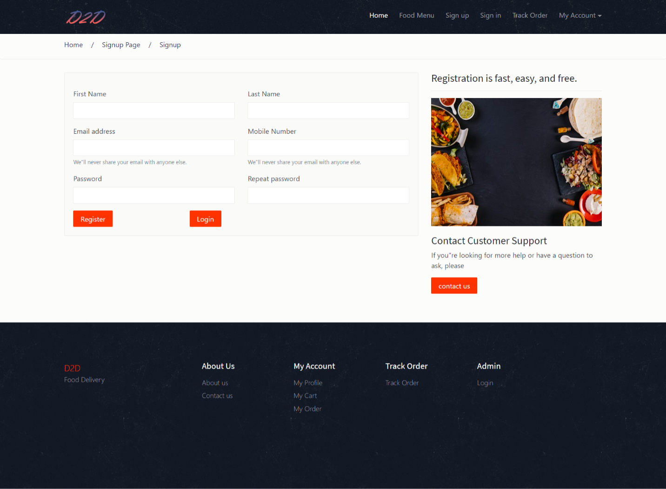
Sign Up Page

Slide 24
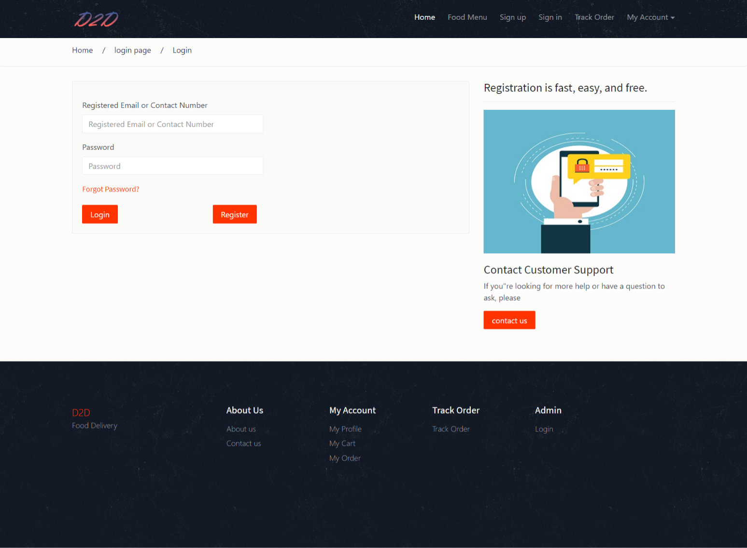
Login Page

Slide 25
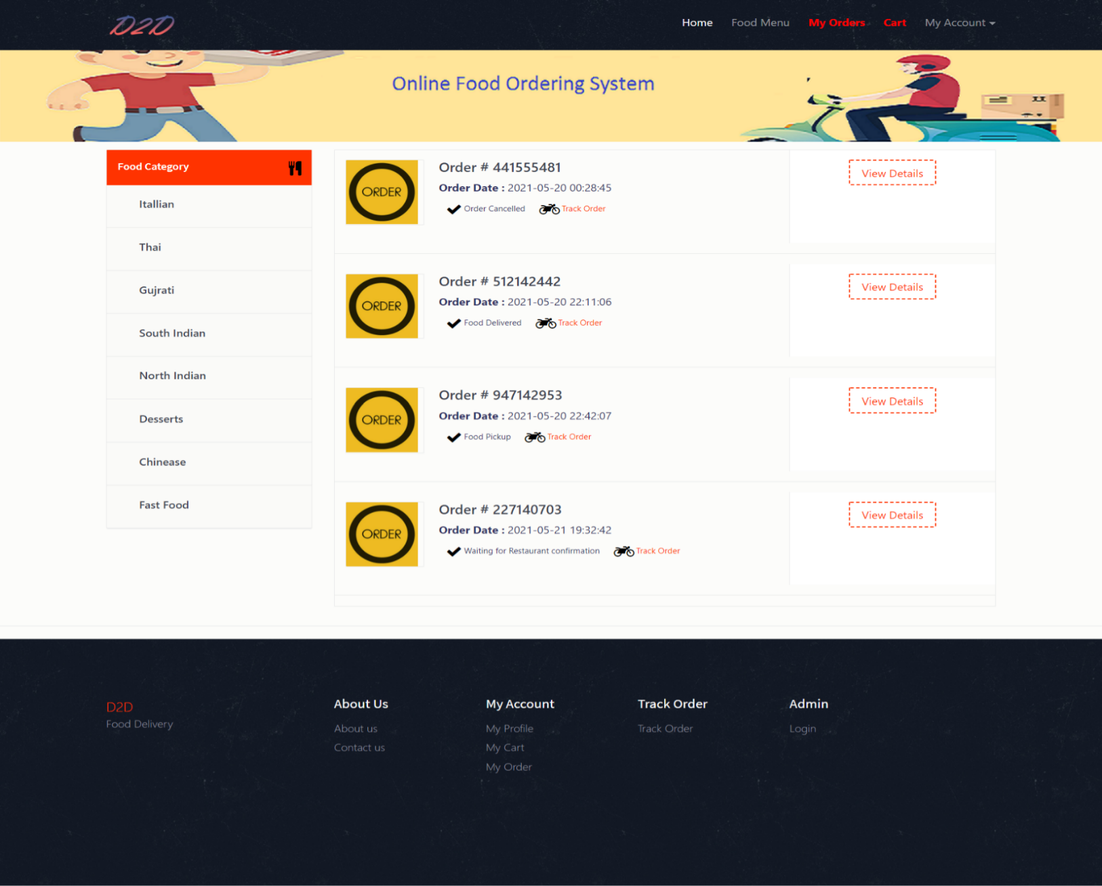
My Oder Page

Slide 26
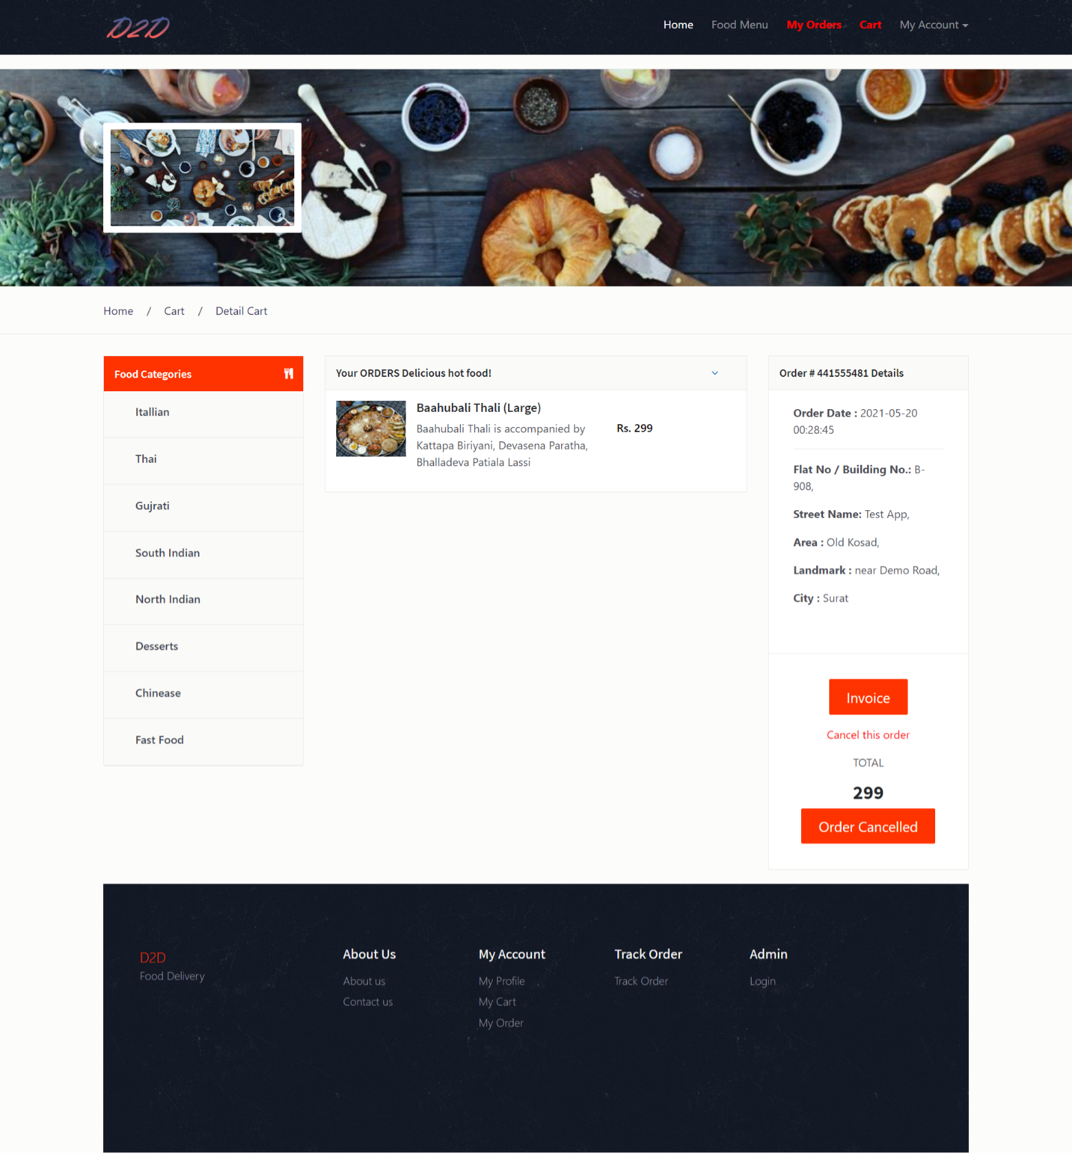
Order Details Page

Slide 27
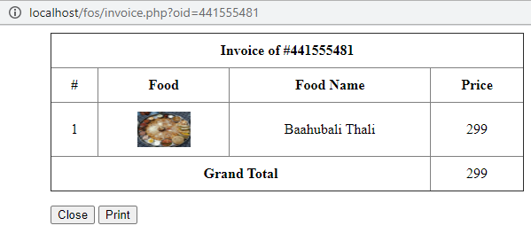
Invoice Of Order

Slide 28
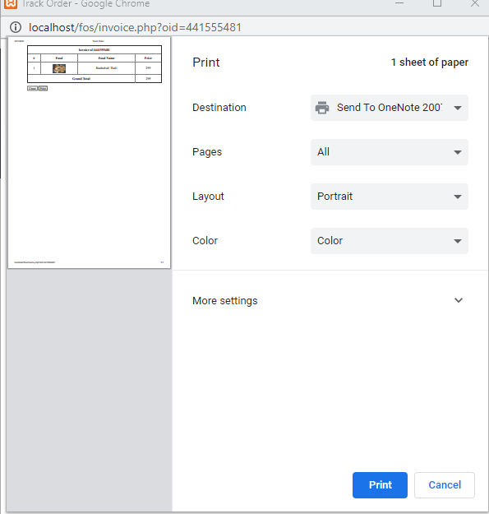
Print In Voice

Slide 29
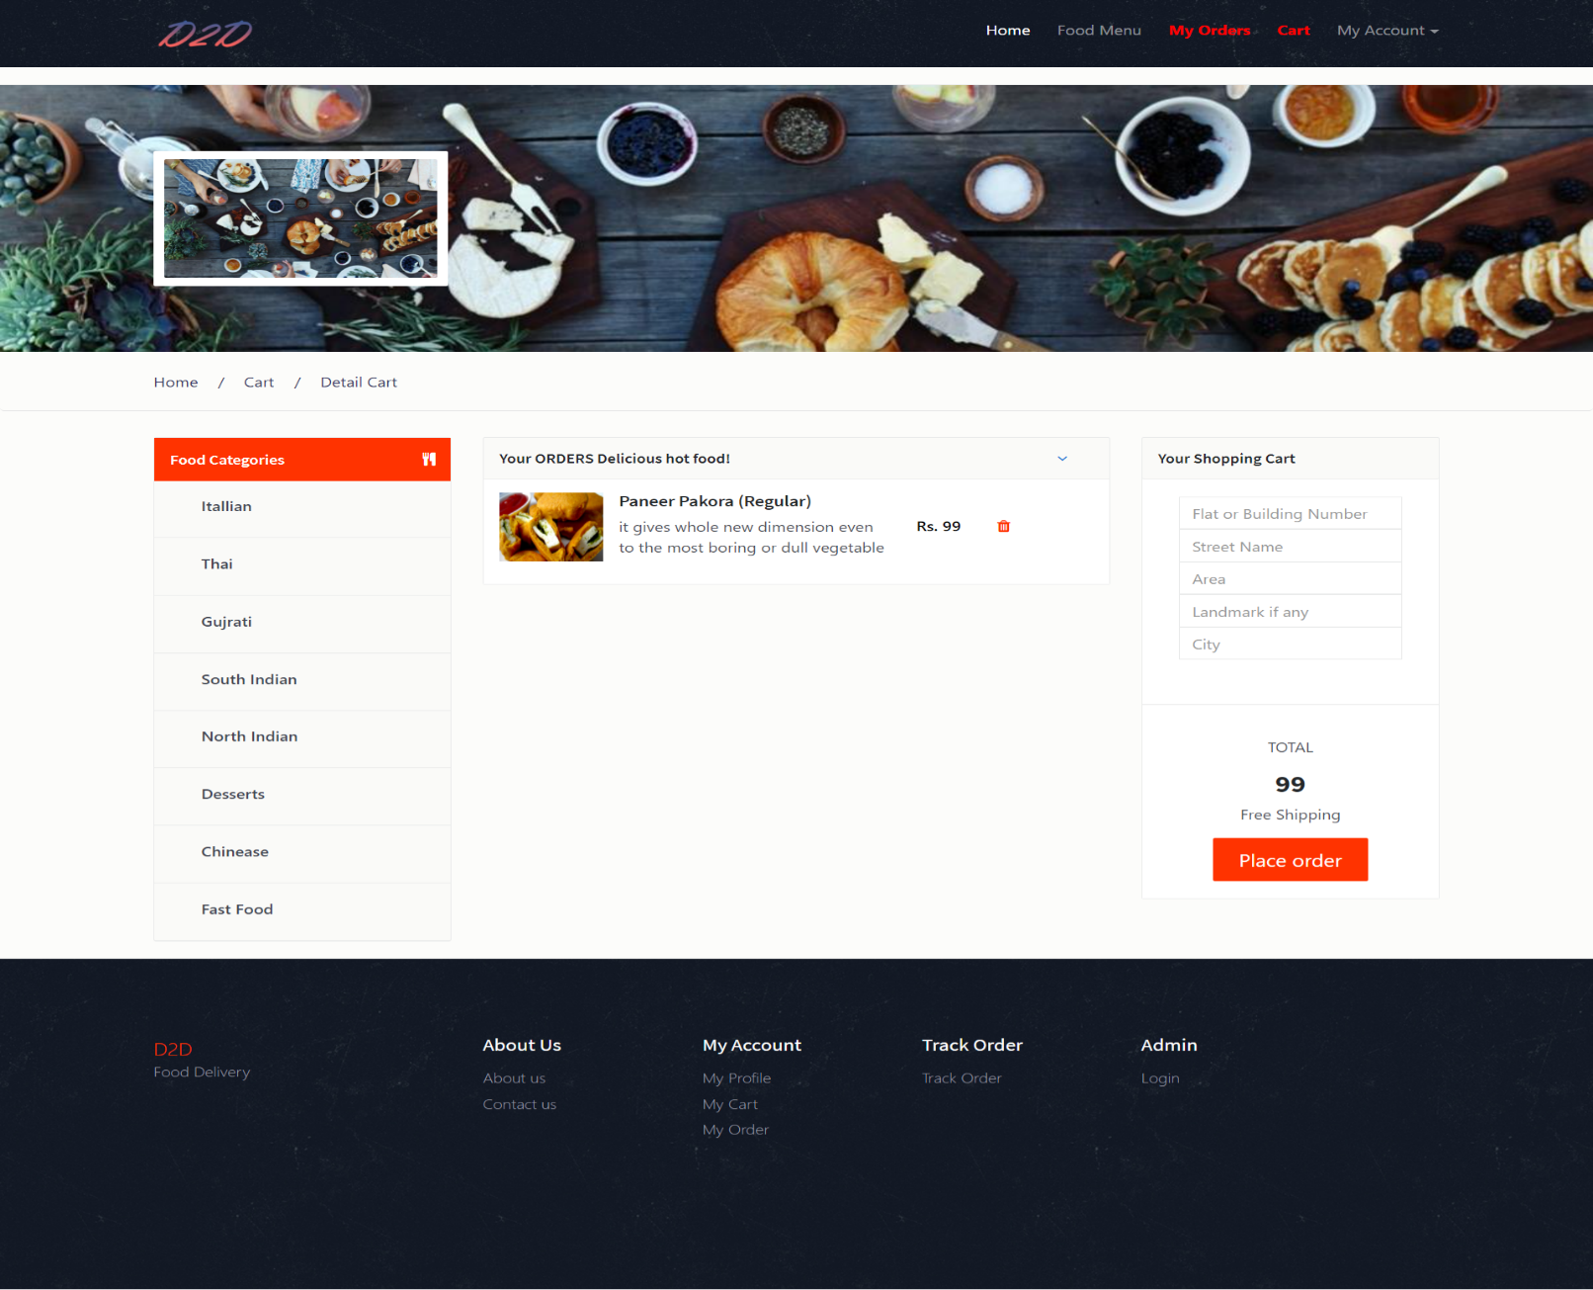
Cart Details

Slide 30
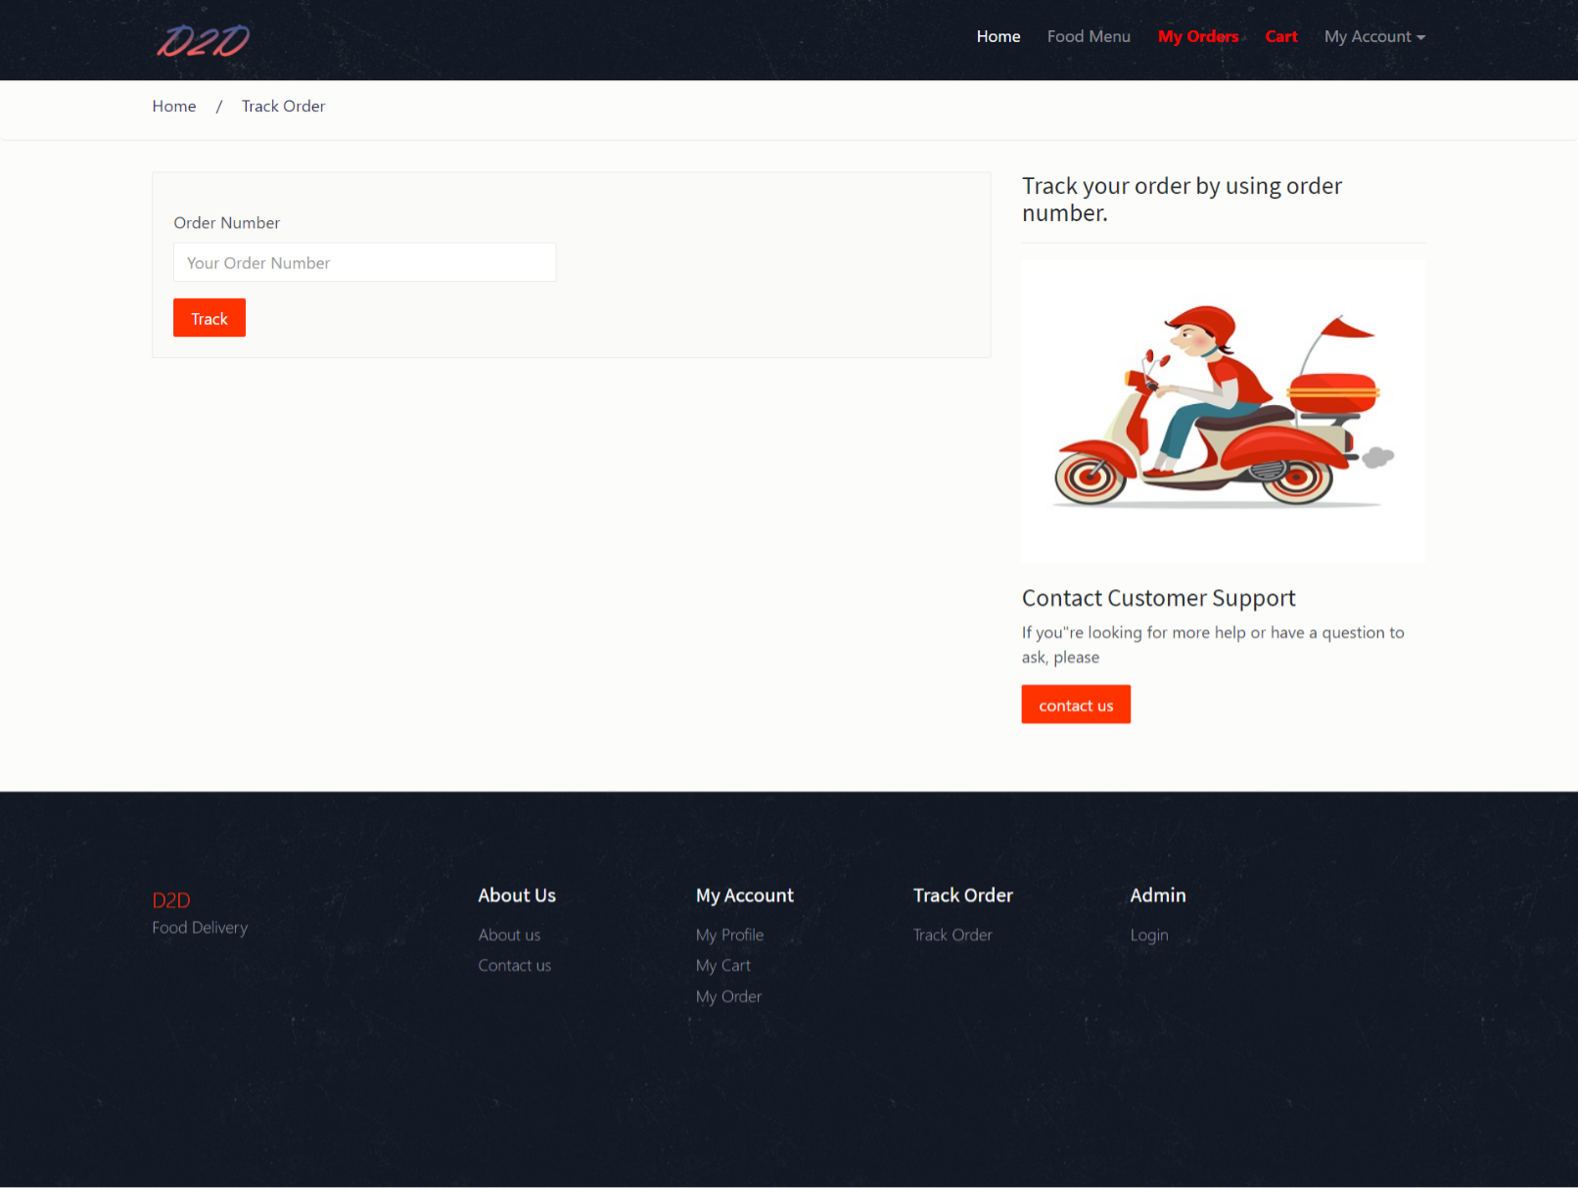
Track Order

Slide 31
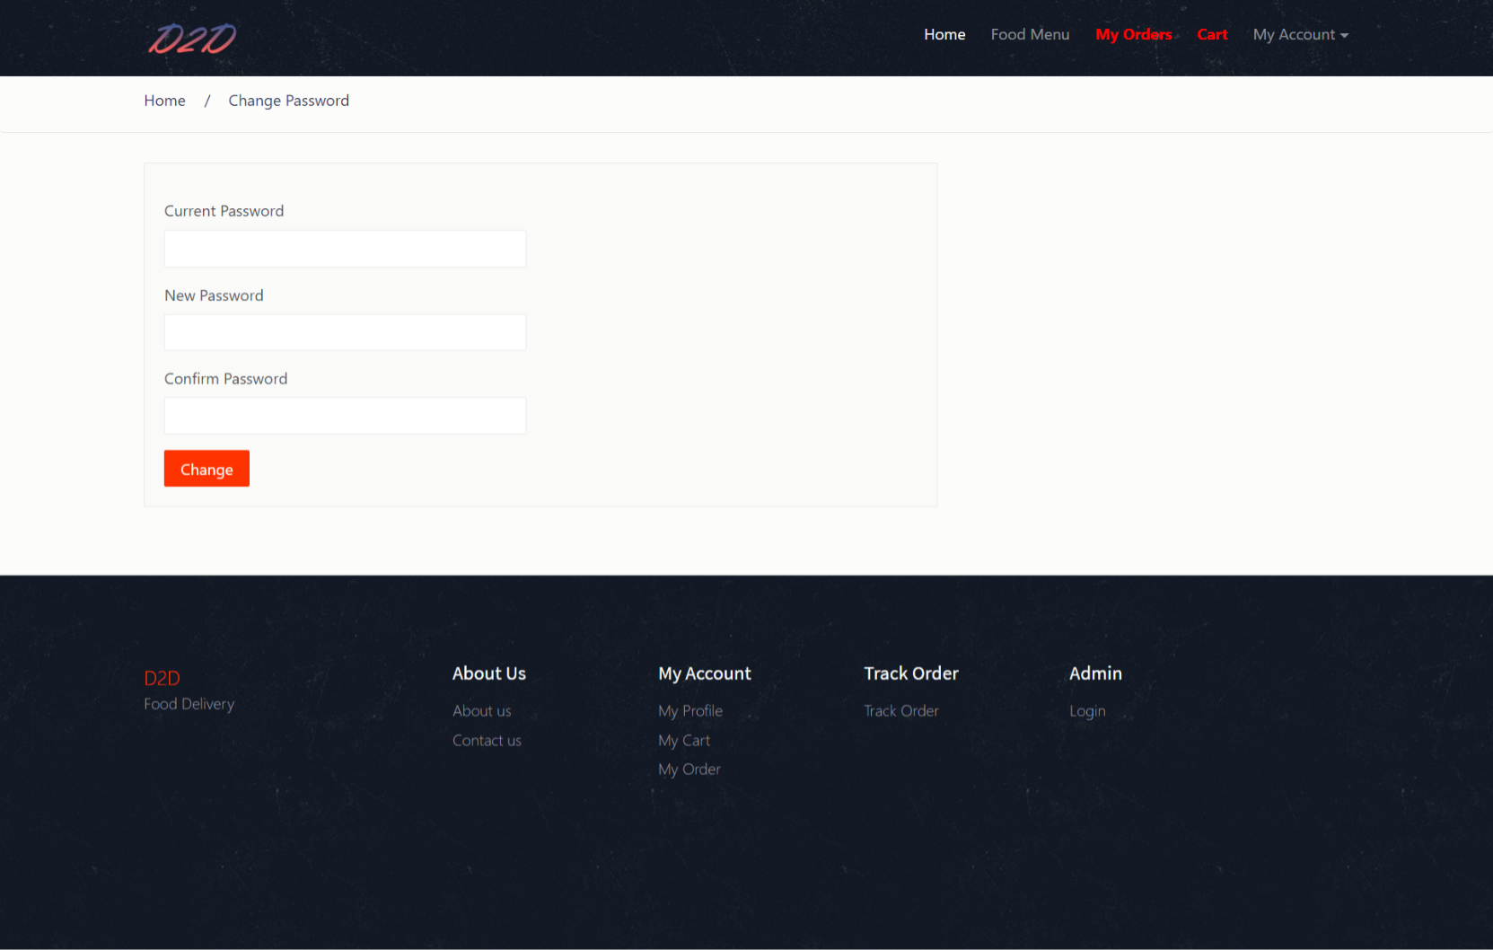
Change Password

Slide 32
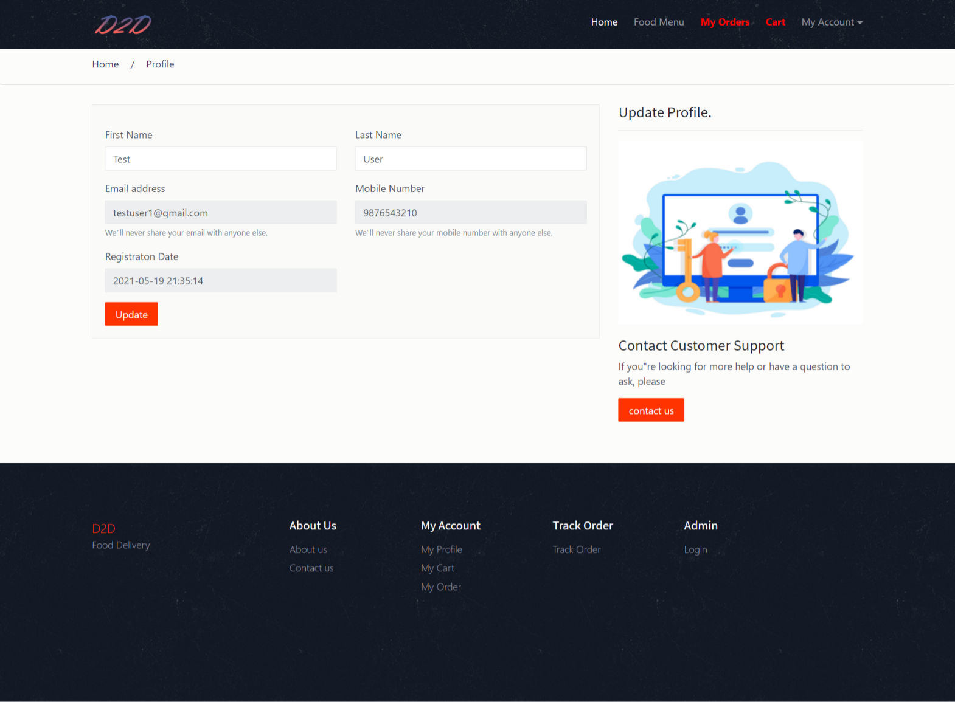
User Profile

Slide 33
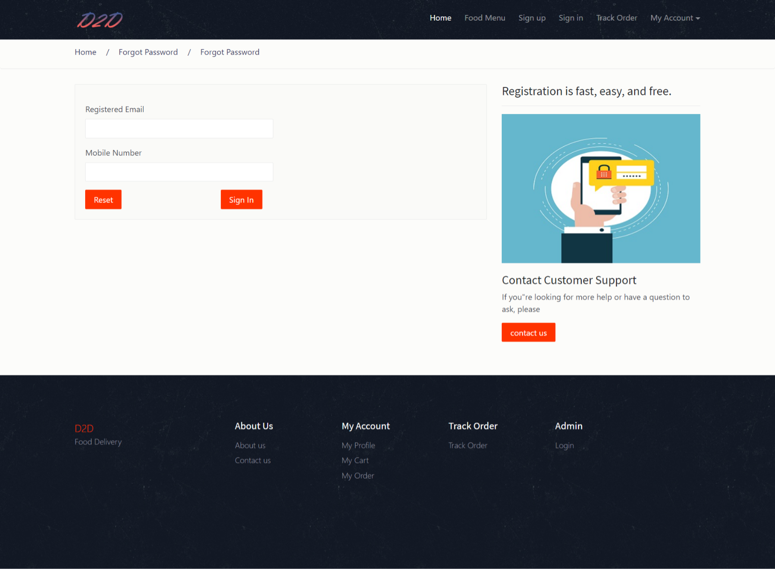
Forgot Password

Slide 34

Reset Password

Slide 35
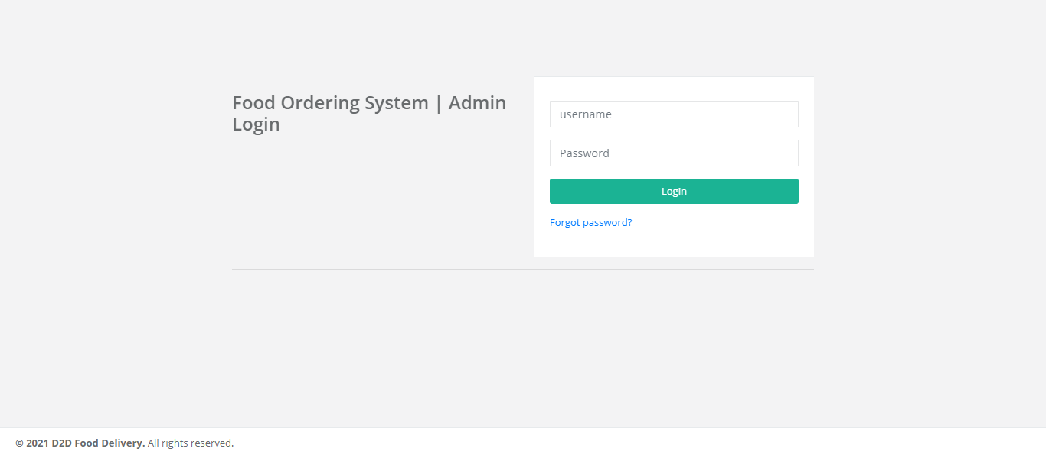
Admin Login

Slide 36
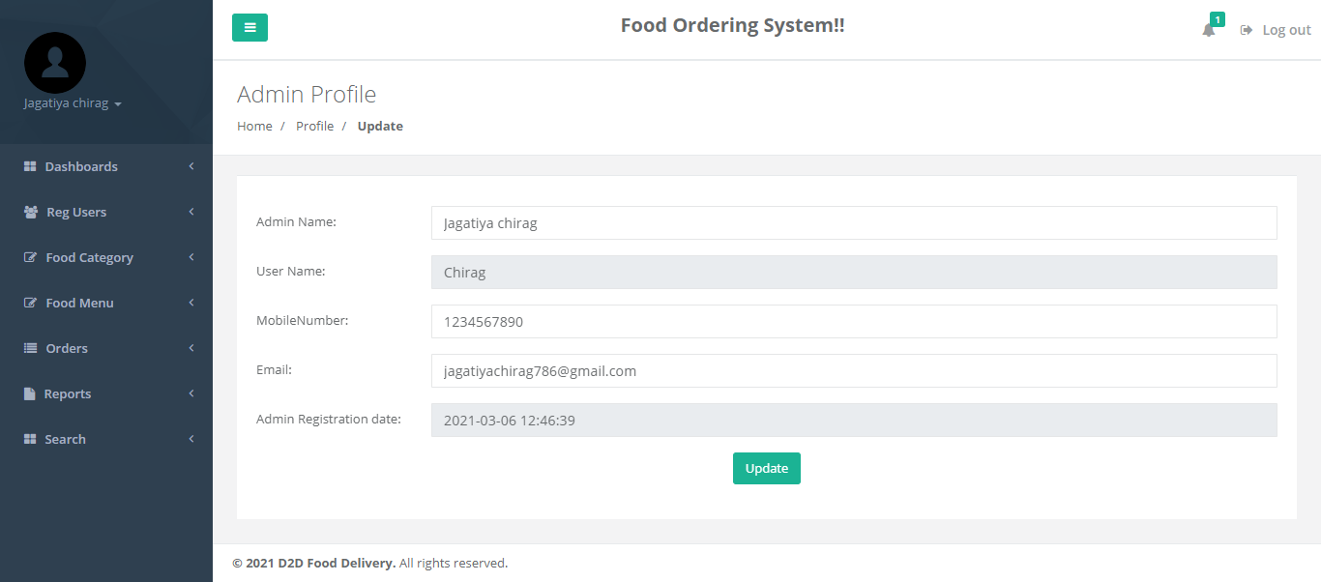
Admin Profile Page

Slide 37
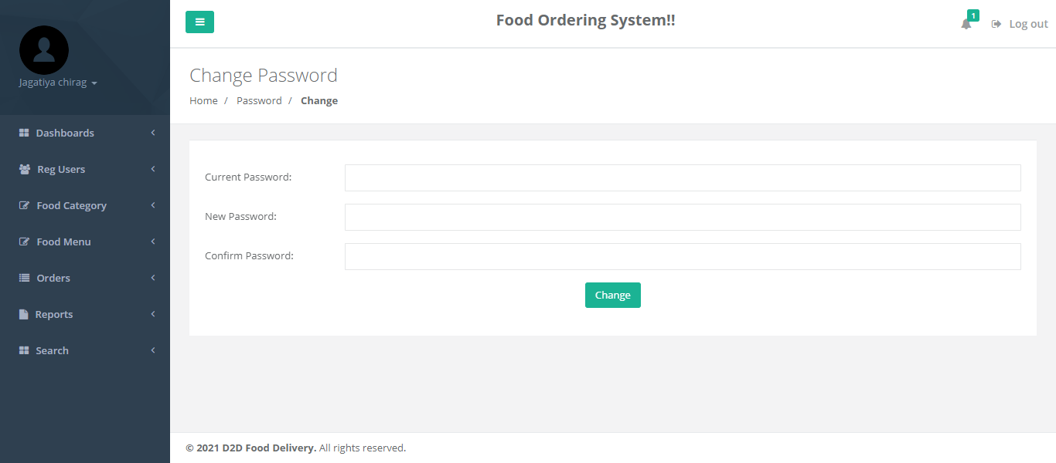
Change Password

Slide 38
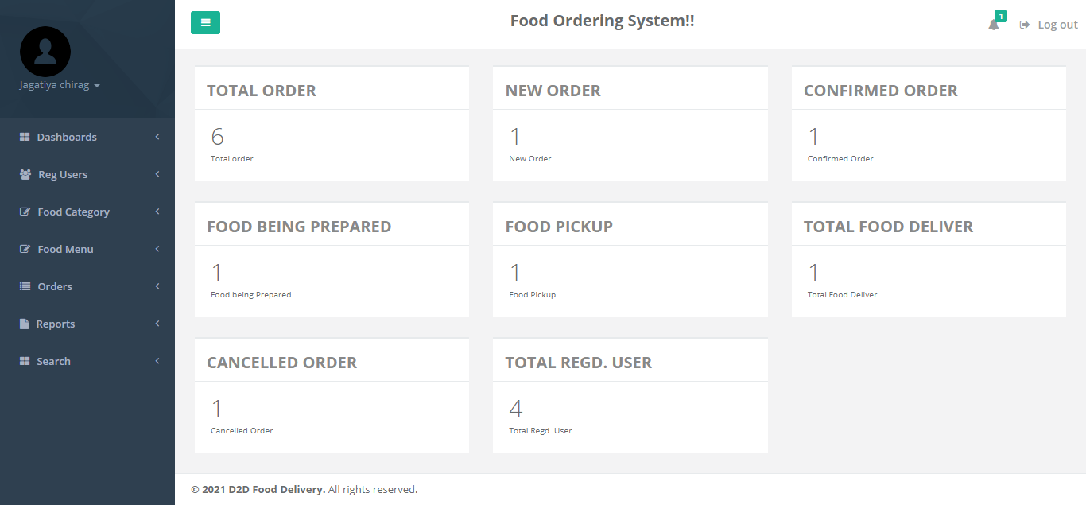
Admin Dashboard

Slide 39
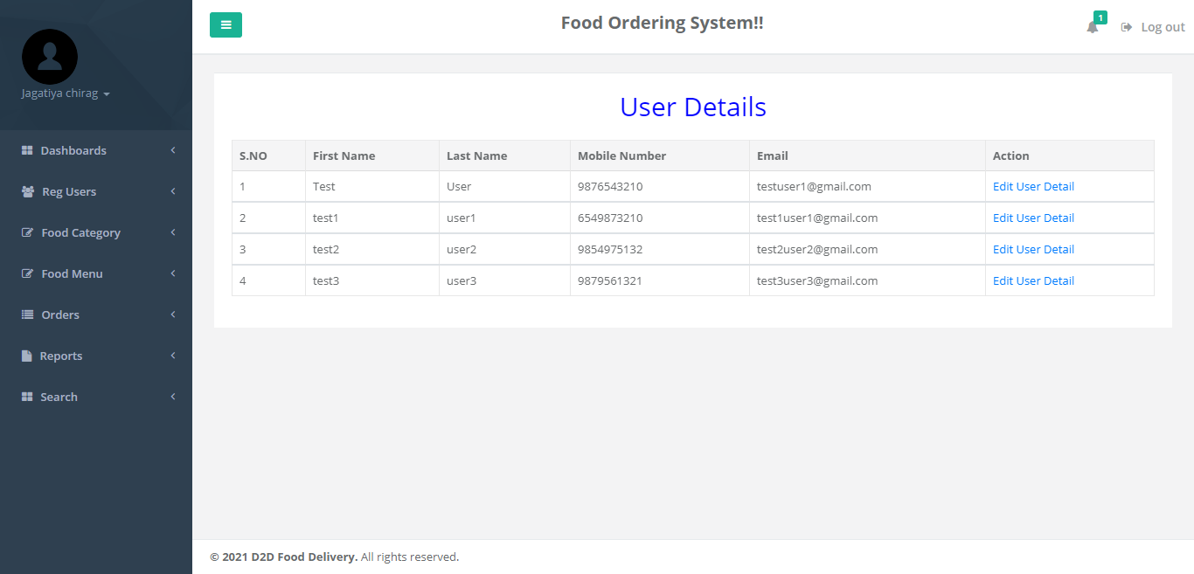
Users Details

Slide 40
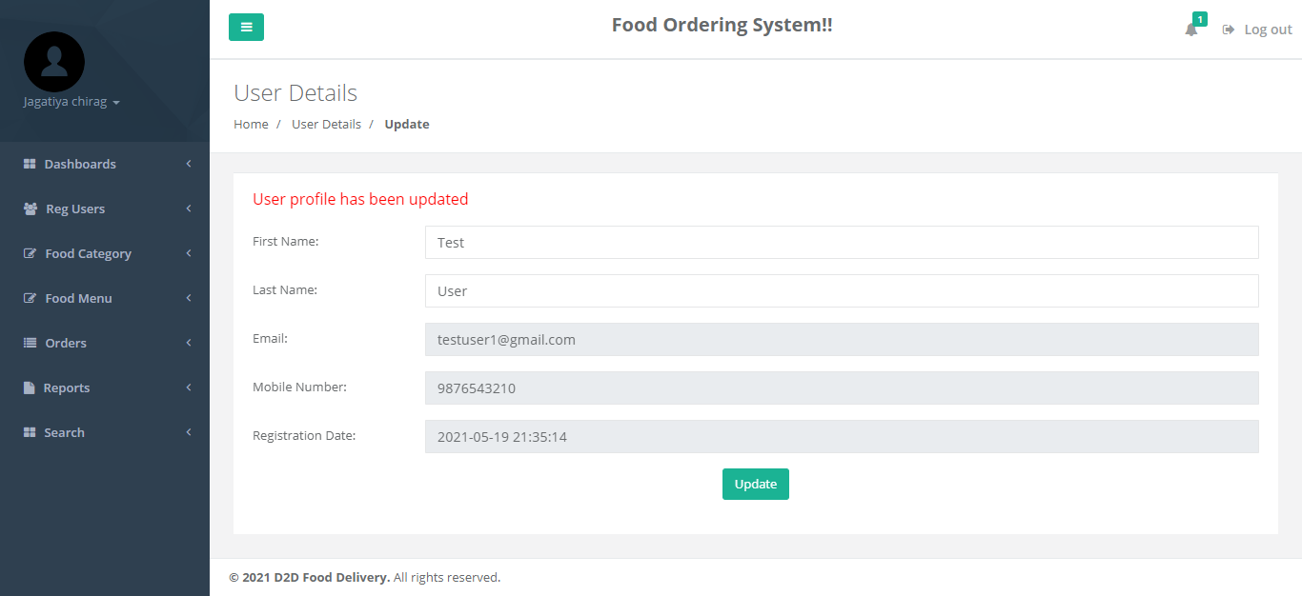
User Detail Edit Page

Slide 41
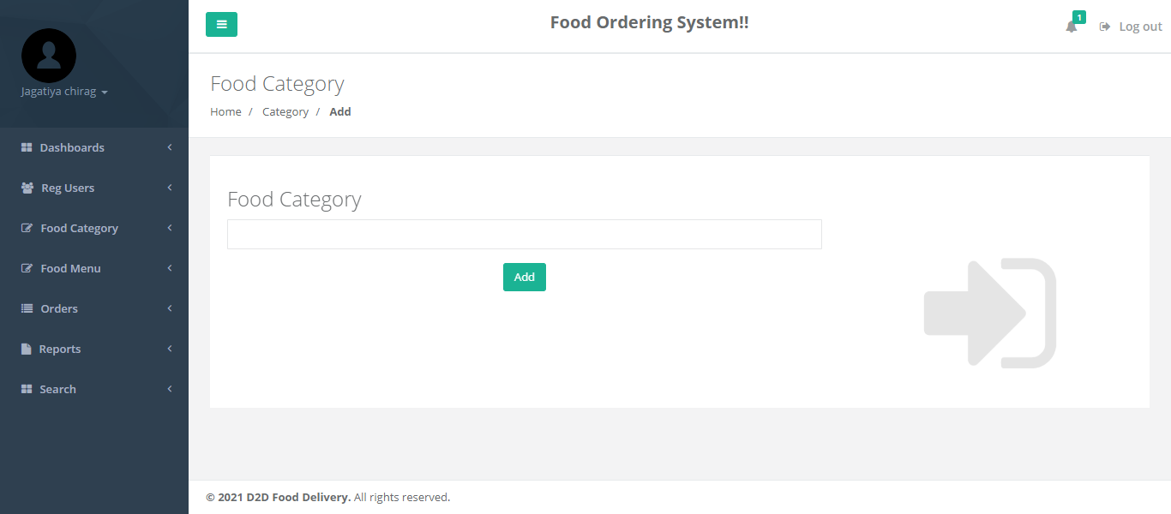
Add Food Category

Slide 42
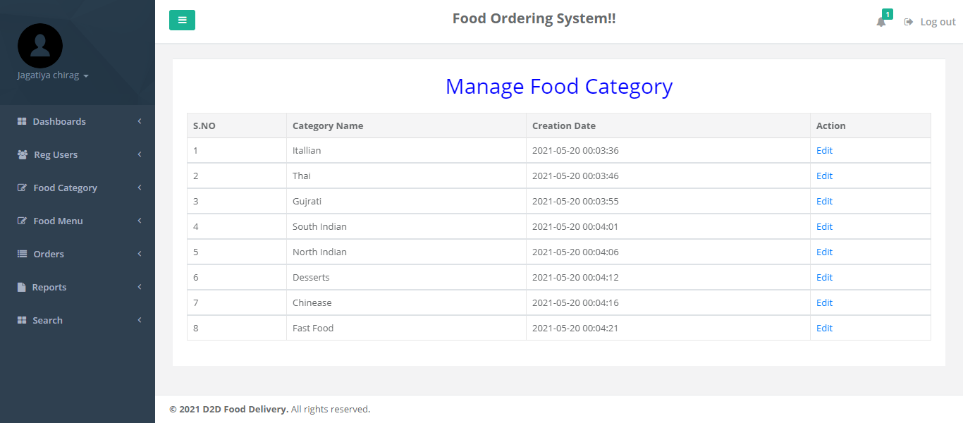
Manage Food Category

Slide 43
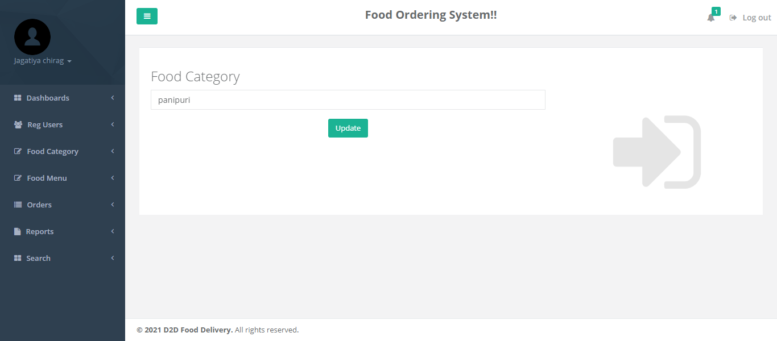
Edit Food Category

Slide 44
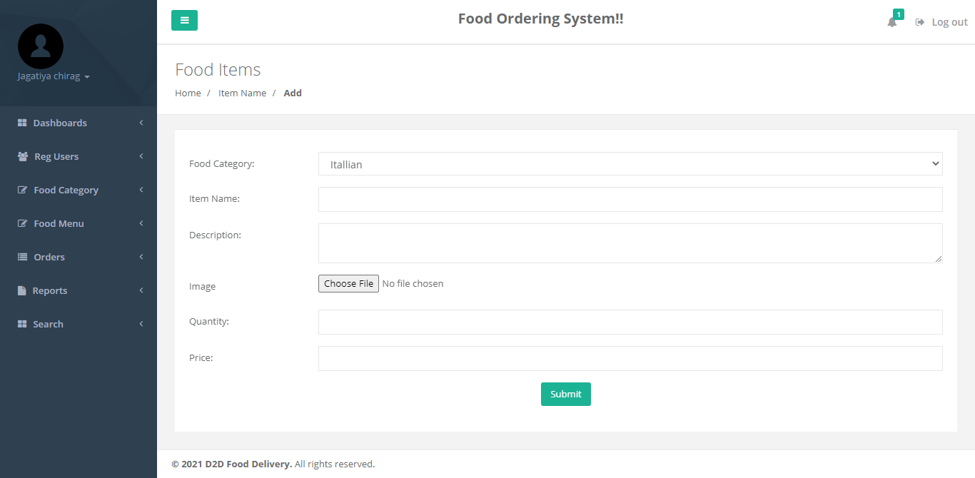
Add Food Items

Slide 45
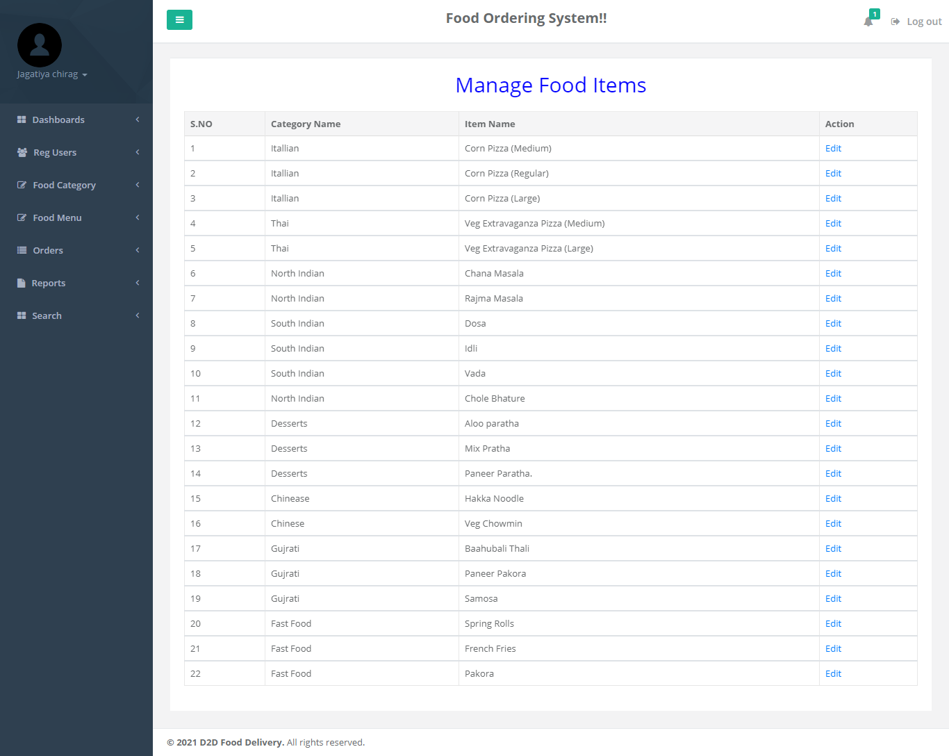
Manage Food Items

Slide 46
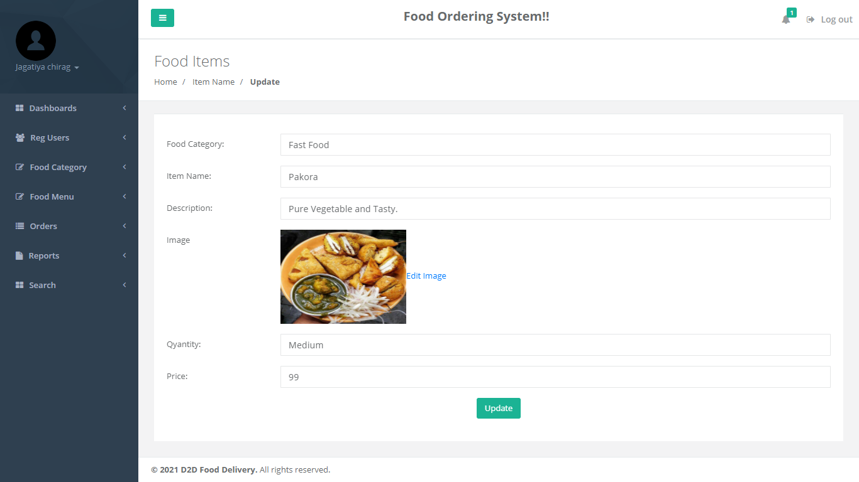
Edit Food Items

Slide 47
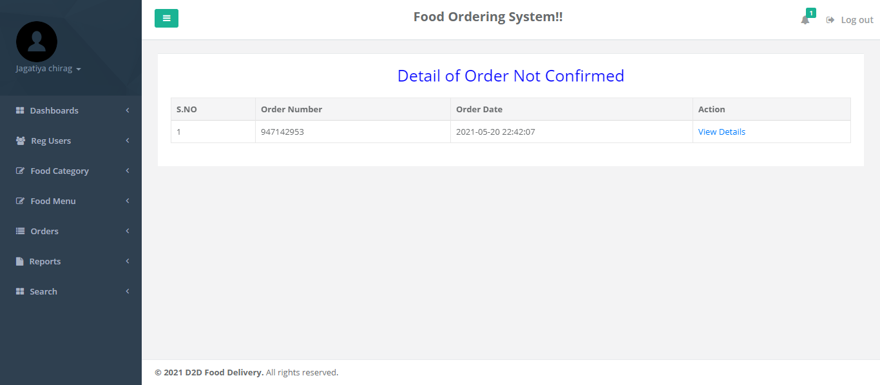
Not Confirmed Order

Slide 48
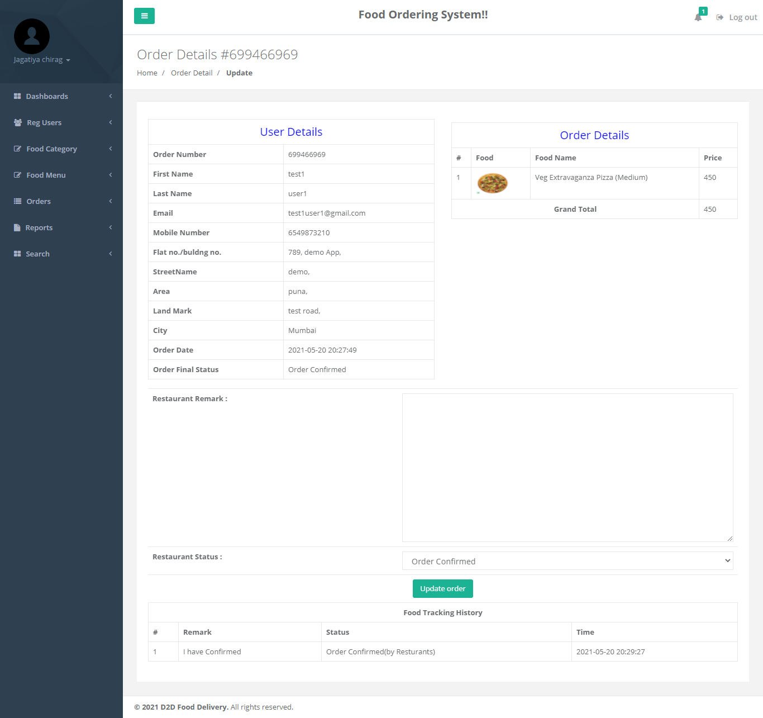
Detail of Confirmed order

Slide 49
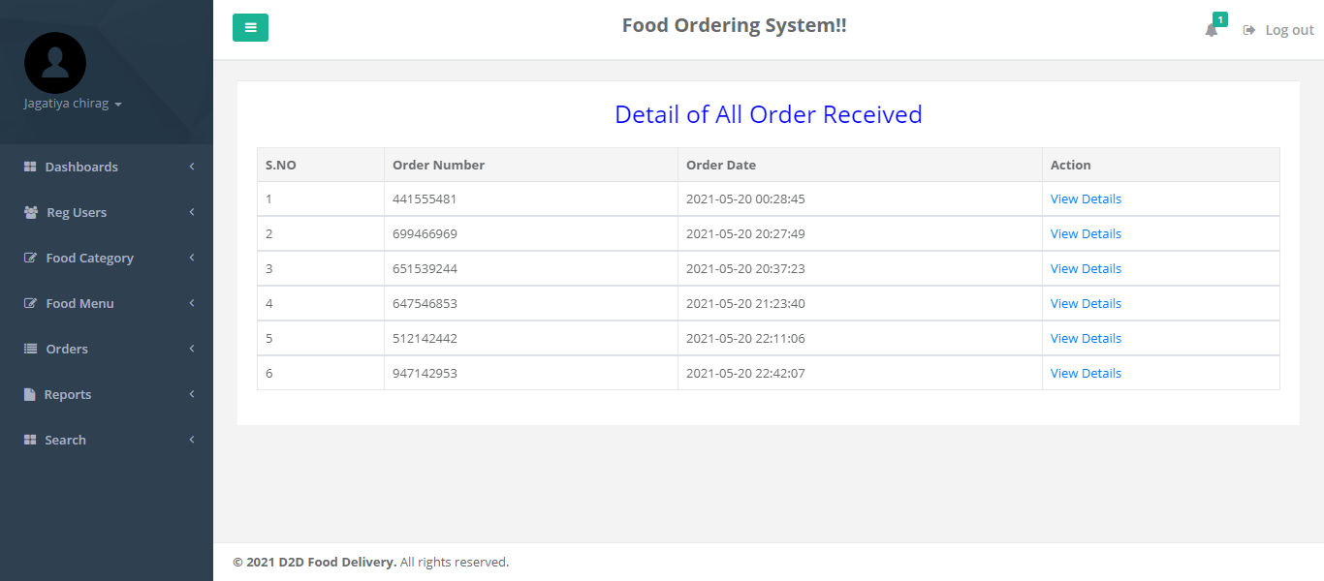
Detail Of Order Received

Slide 50
View Details Of All Order

Slide 51
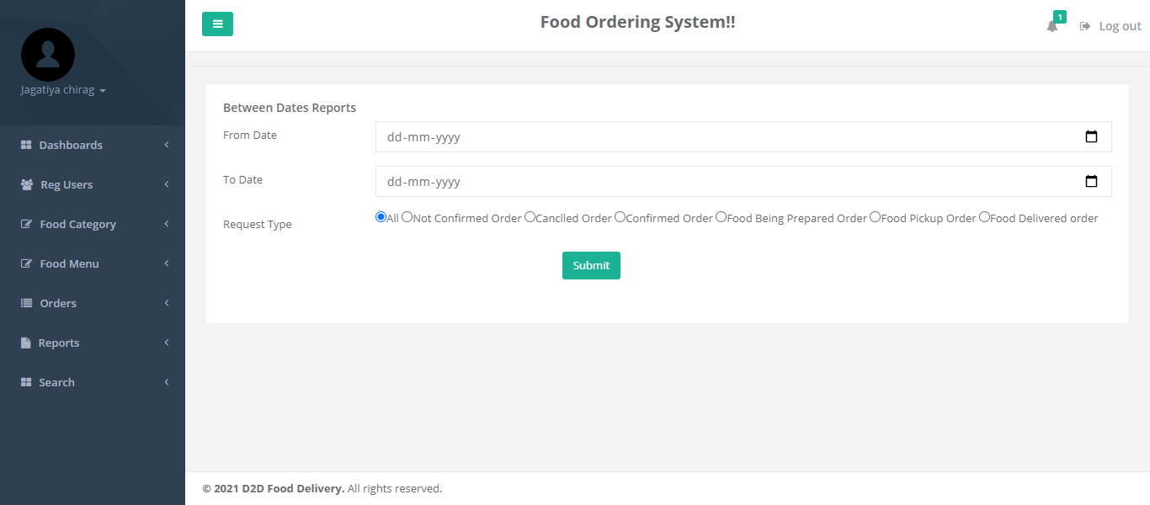
B/W Dates Report

Slide 52
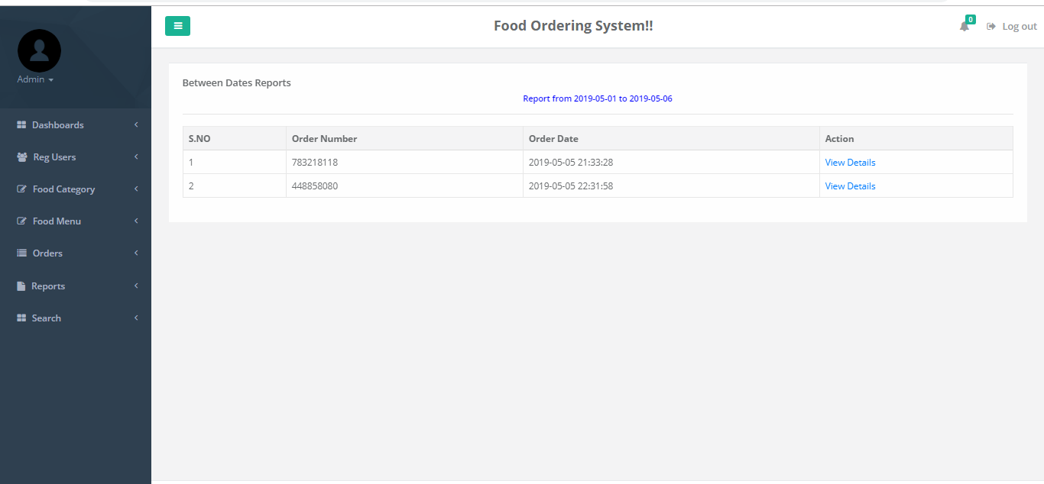
Details Of B/W Reports Dates

Slide 53
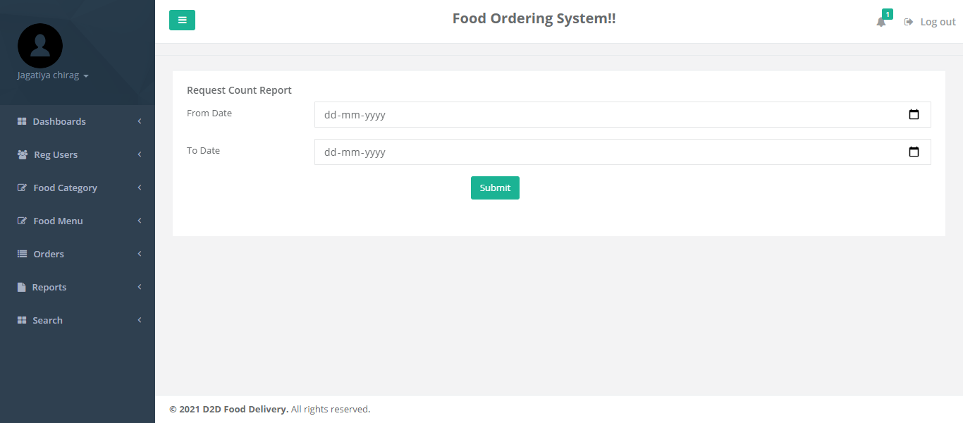
Order Count Report

Slide 54
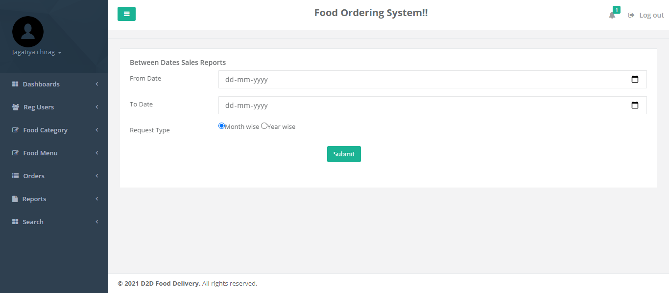
Sales Report

Slide 55

Thank You…

